Slide 1
Conceptual Modeling EXAMPLE Highline University

Slide 2
Highline University Creating a Data Model
Suppose the administration at a hypothetical university named Highline University wants to create a database to track colleges, departments, faculty, and students.
To do this, a data modeling team has collected a series of reports as part of its requirements determination.

Slide 3
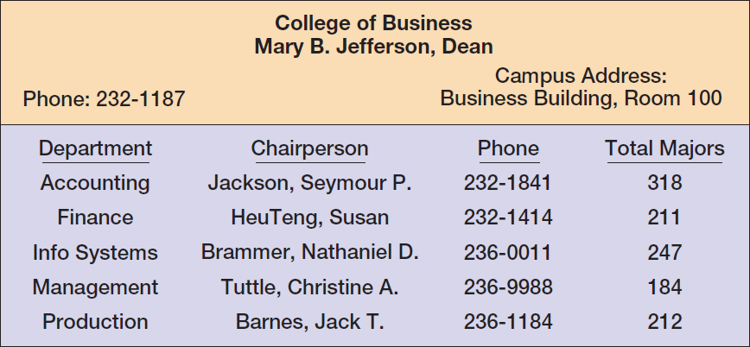
Highline University The College Report

Slide 4
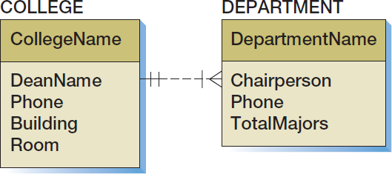
Highline University First Data Model
Interpretation?
A college has one to many departments; a department is required to belong to one and only one college.

Slide 5
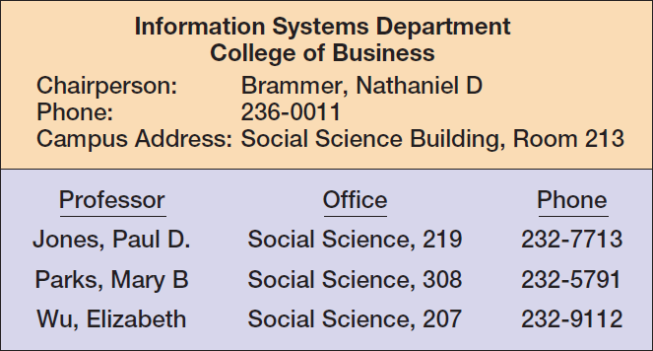
Highline University The Department Report

Slide 6
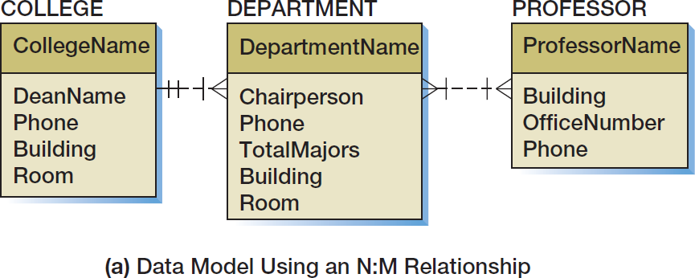
Highline University Second Data Model I

Slide 7
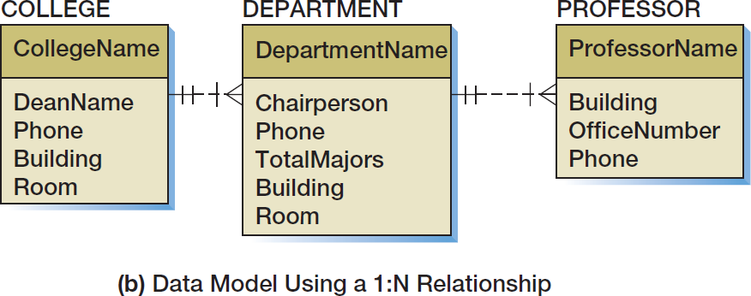
Highline University Second Data Model II

Slide 8
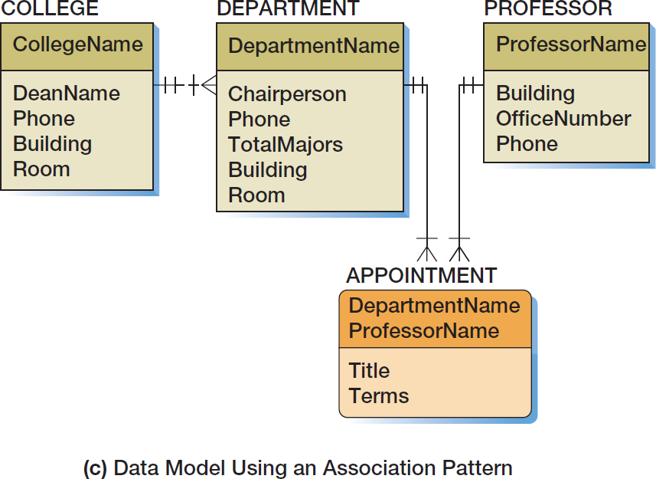
Highline University Second Data Model III

Slide 9
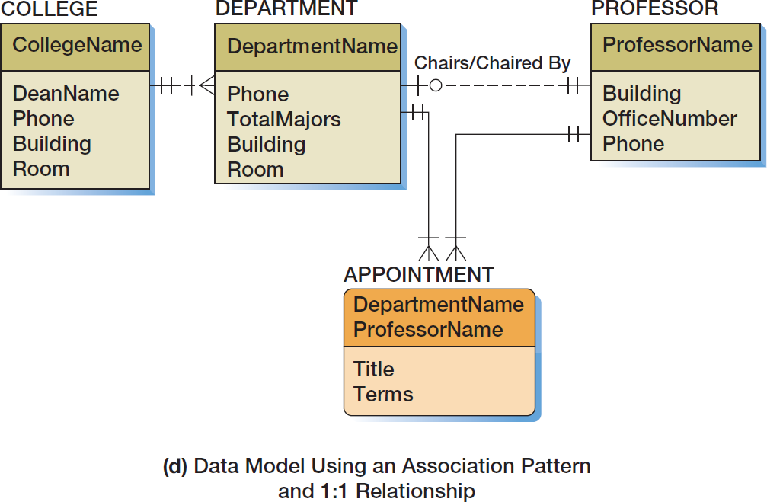
Highline University Second Data Model IV

Slide 10
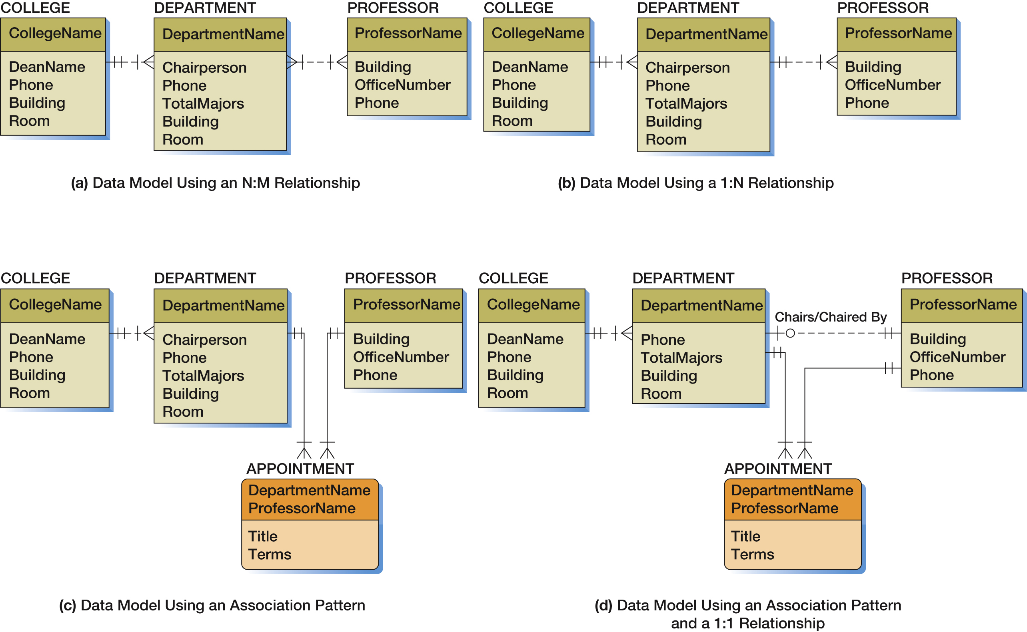
Figure 5-47 Alternate Data Models for the DEPARTMENT-to-PROFESSOR Relationships
What does this tell you?

Slide 11
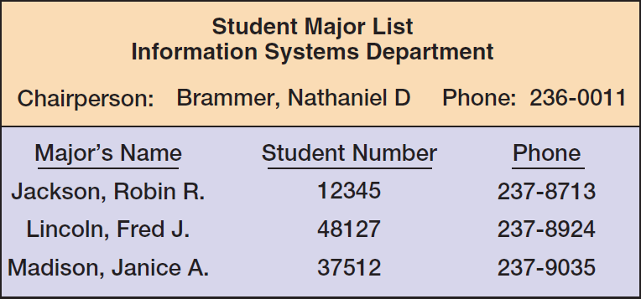
Highline University The Department Student Report

Slide 12
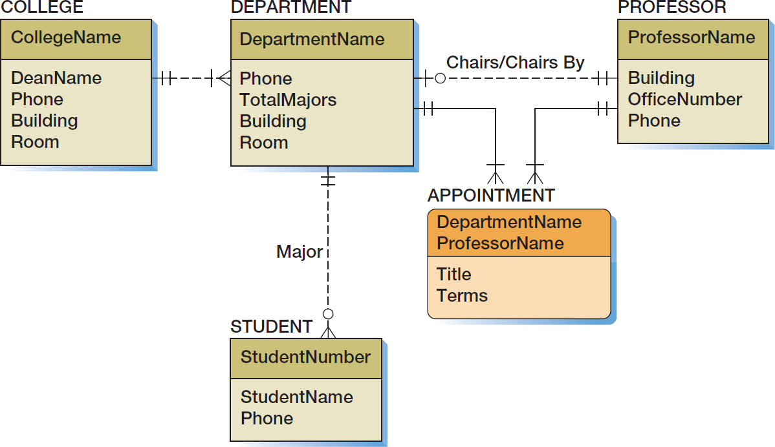
Highline University Third Data Model

Slide 13
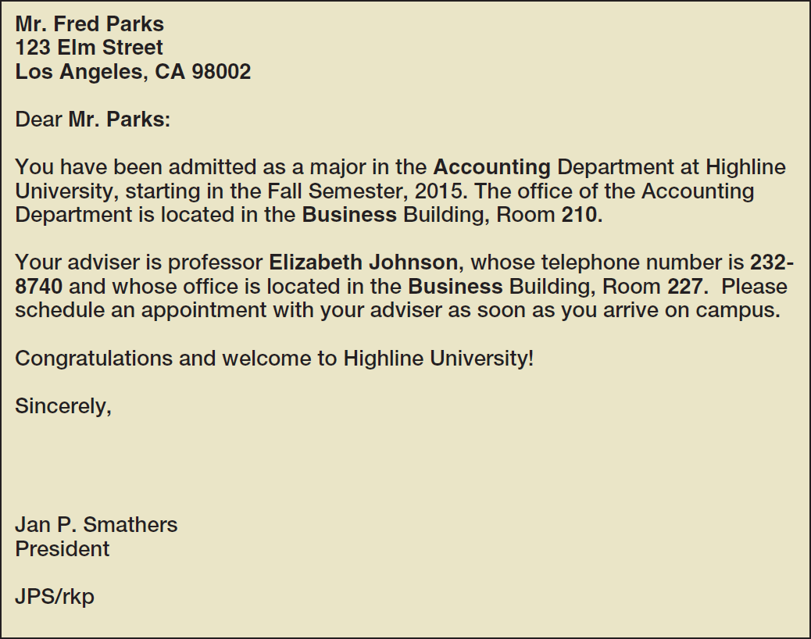
Highline University Sample Student Acceptance Letter

Slide 14
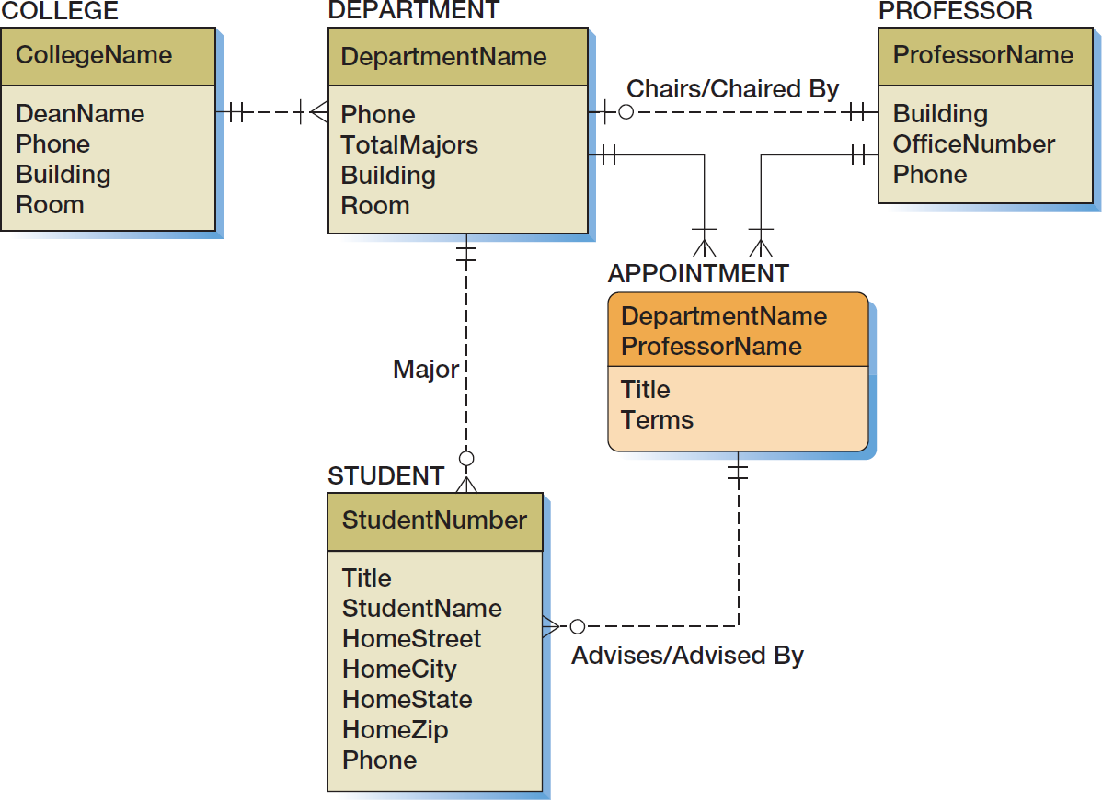
Highline University Fourth Data Model

Slide 15
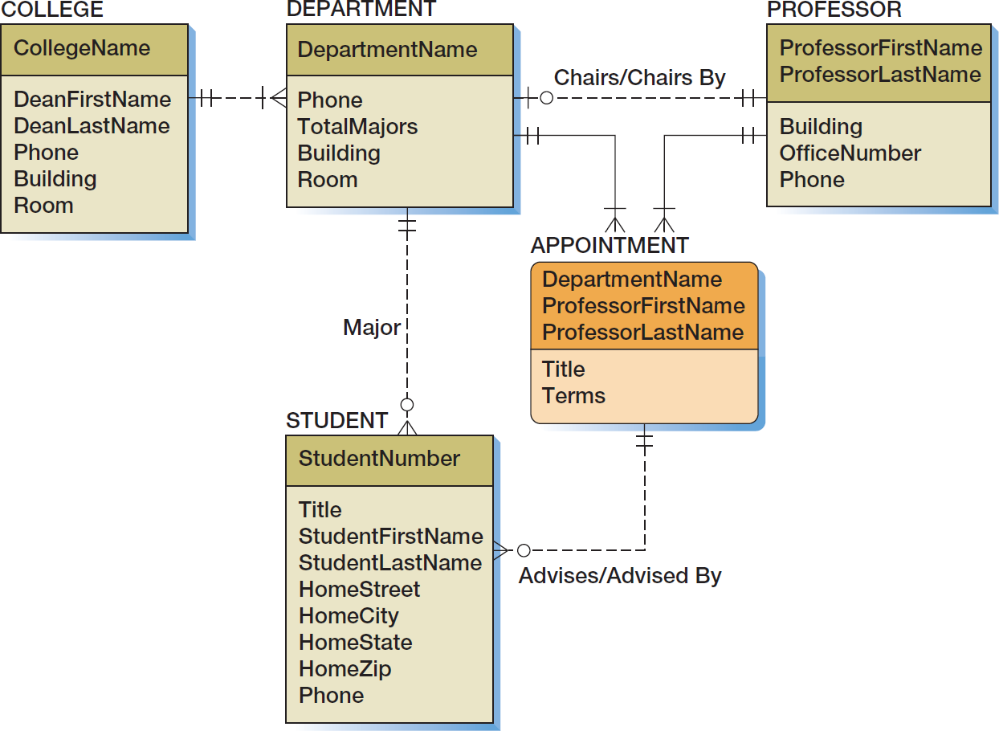
Highline University Final Data Model
Note: more than one relationship between two entities.

Slide 16
QUESTIONS?
Can you draw a conceptual model given a description or the application domain or reports that are in use?

